Slide 1

All Digital LDO
Huan-Cheng Liao
Gerald Topalli

Slide 2
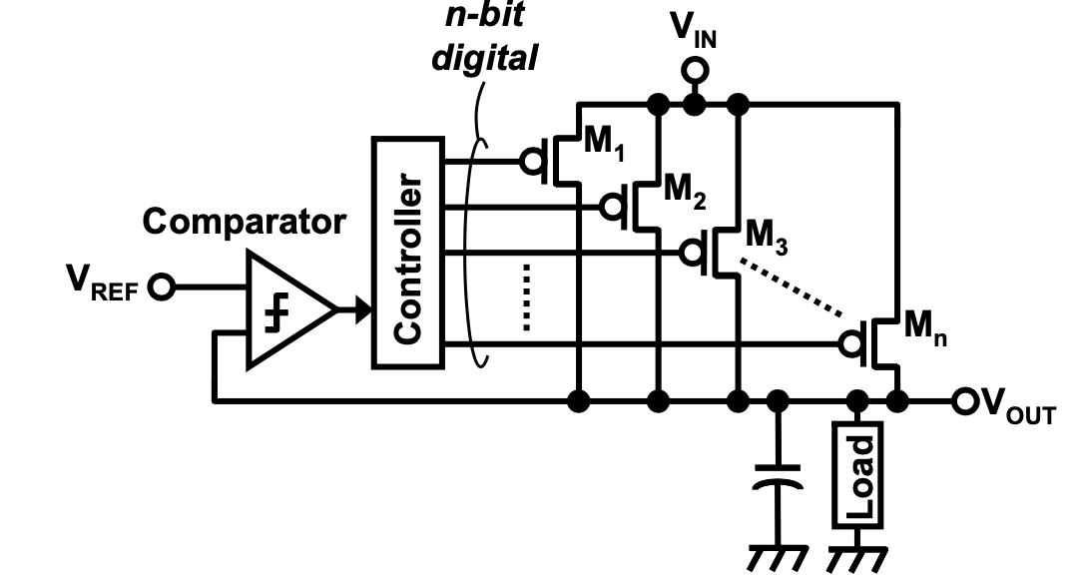
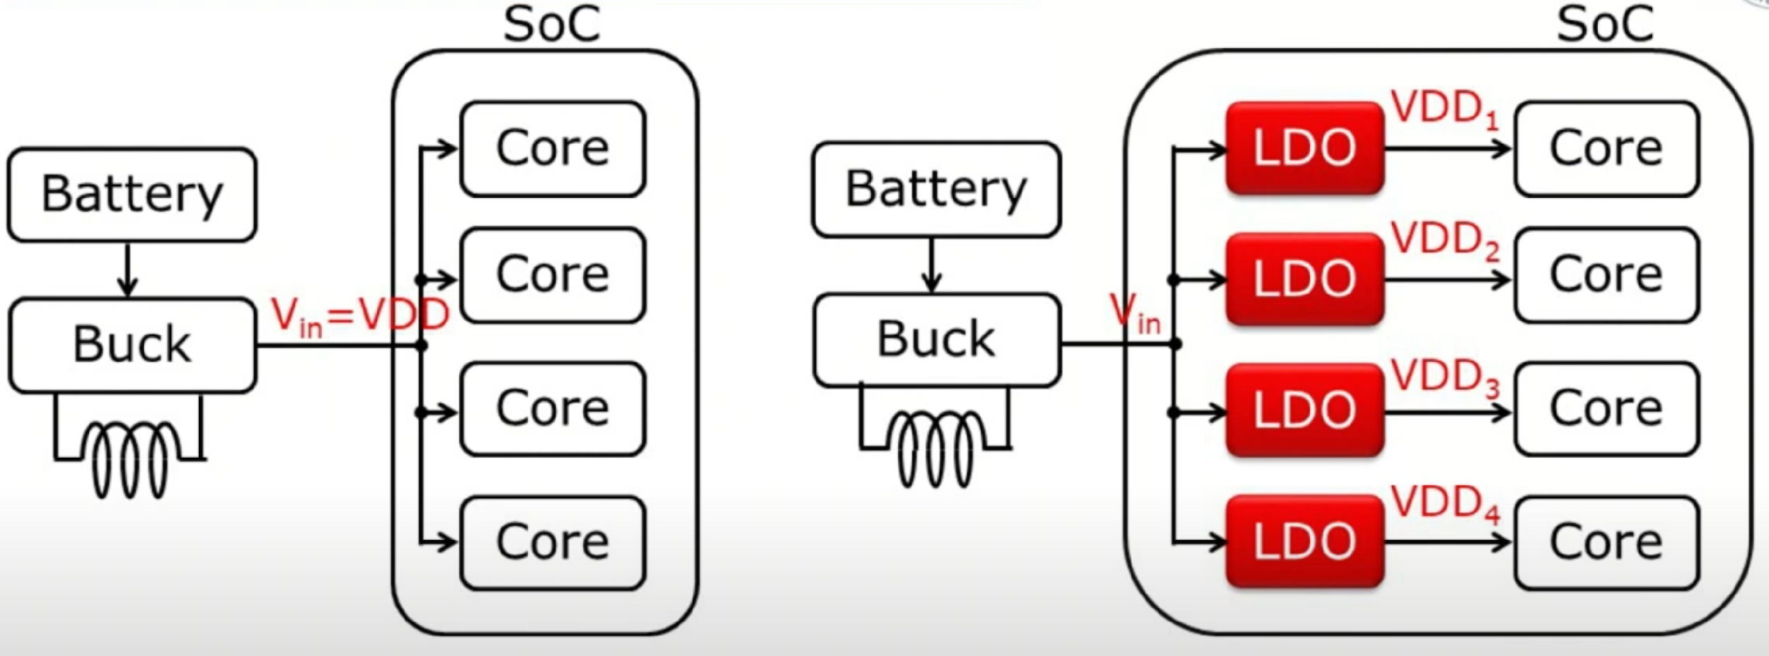
Why Digital LDO?
LDO-s can enable per-core voltage domain
Low voltage operation (ex. 0.5V for near-threshold logic)
Loop gain is independent of operating voltage.

Slide 3
Working principle
The comparator senses whether the output voltage is higher or lower than the reference voltage
The controller receives the output voltage of the comparator and turns on or off the pmos based on the comparison to control the current

Slide 4
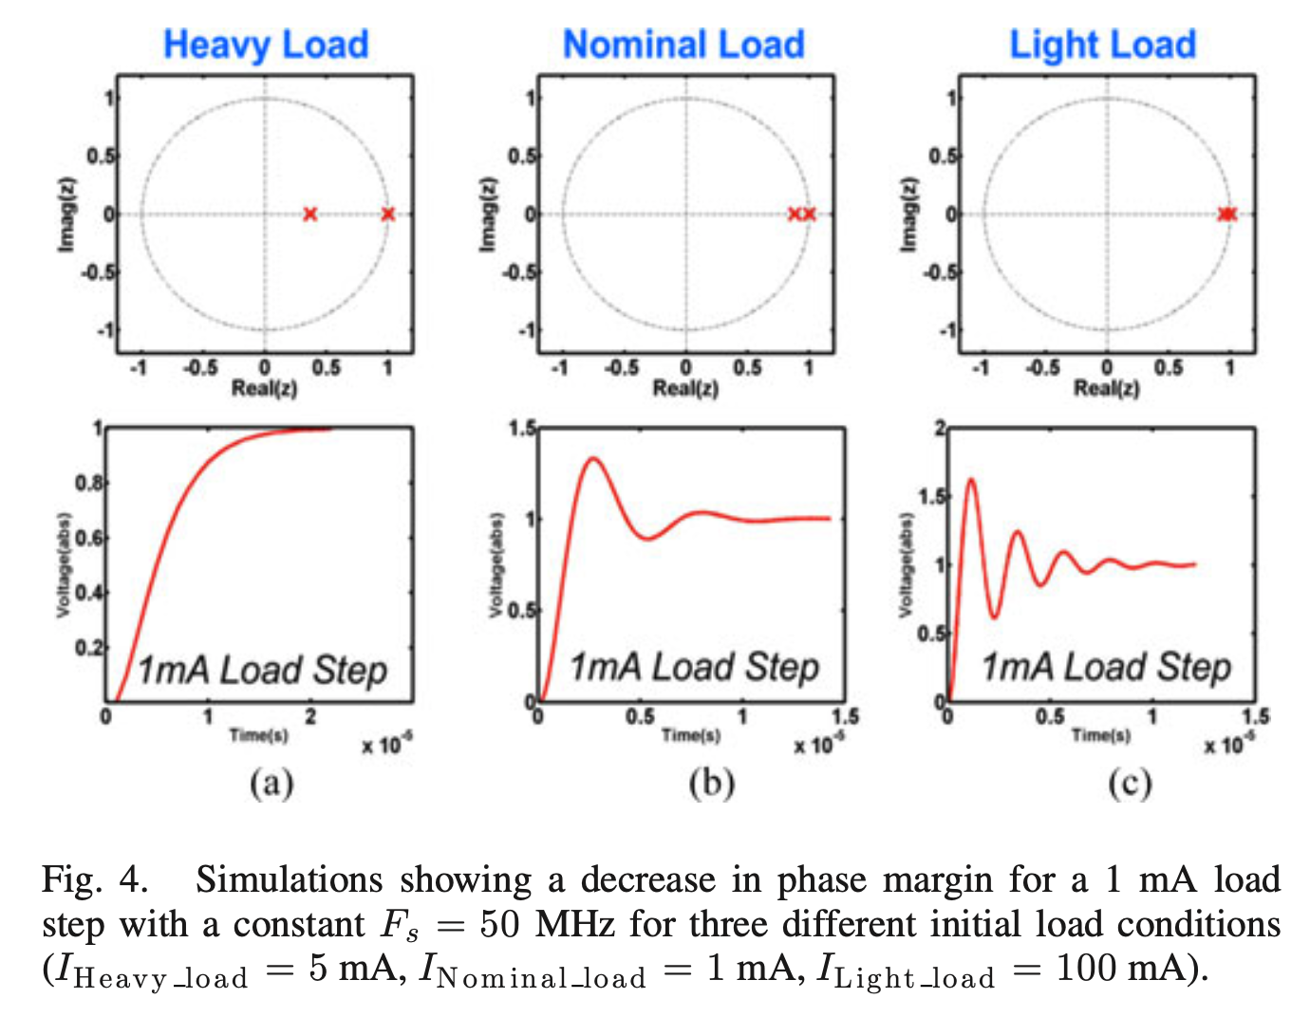
Problems
Sampling frequency adaptation
Motivation:
Consistent damping and maintaining a small ripple during steady state across load range.
Why consistent damping matters?
For an extreme light load conditions, the system can become highly underdamped and unstable.

Slide 5
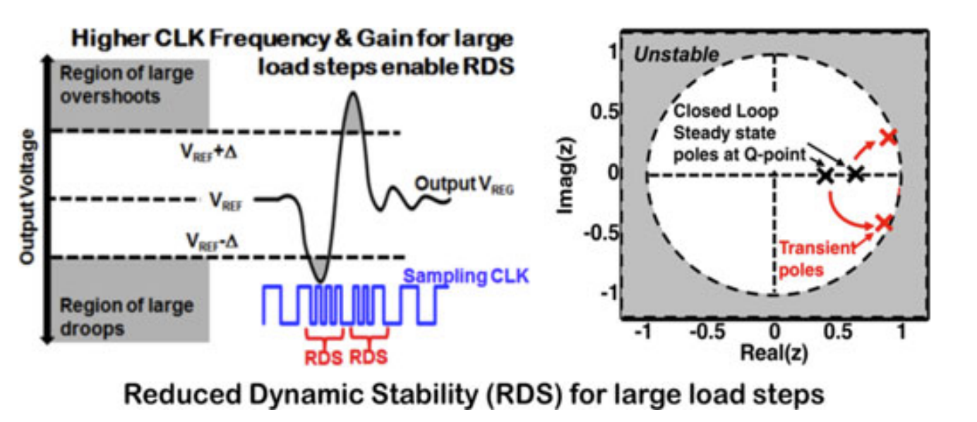
Problems
Transient performance
Motivation:
Digital load circuits exhibits large and infrequent load transients during power or clock gating.
Solution:
For high voltage droops at the output, the sampling frequency is increased (underdamped) to make the system settle faster.

Slide 6
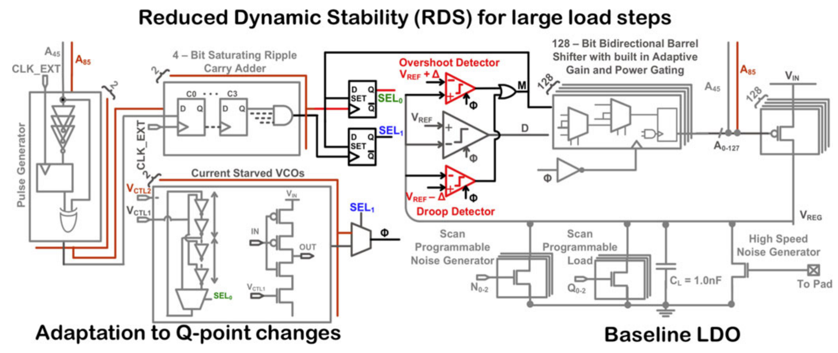
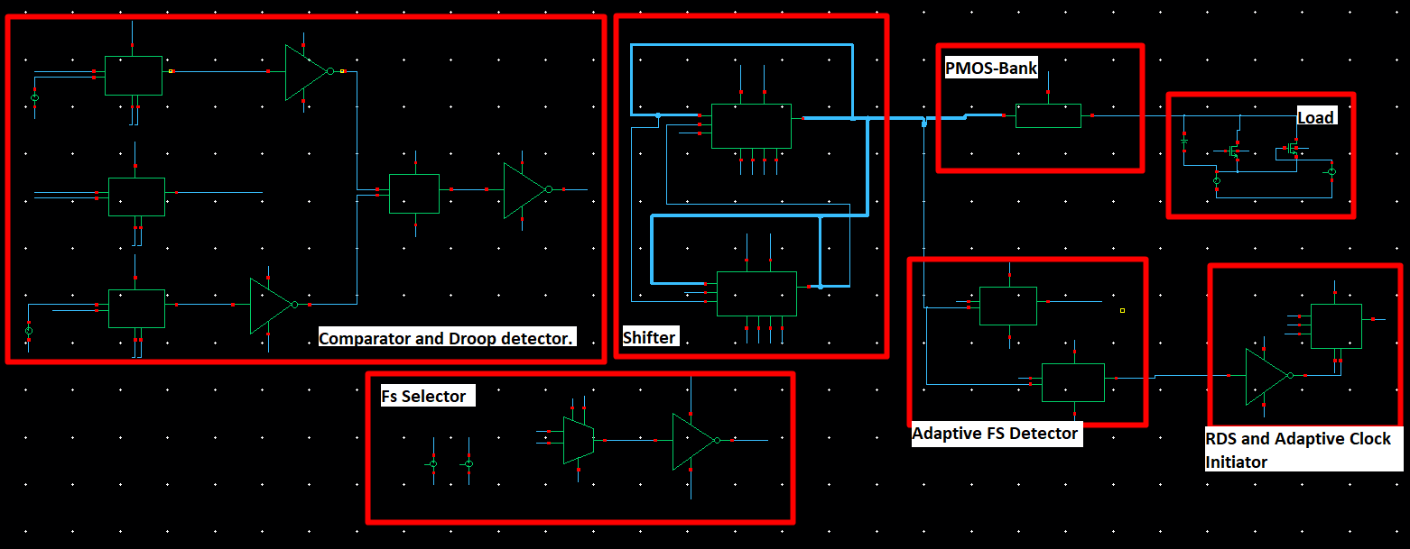
This work

Slide 7
Digital Library
Standard CMOS gates:
AND, NOR, INV, XOR, DFF, Asynchronous DFF, MUX
Other Logic Cores:
Half Adder, Dynamic Comparator, Pulse Generator, 4-bit Counter, Barrel Shifter, PMOS Bank

Slide 8
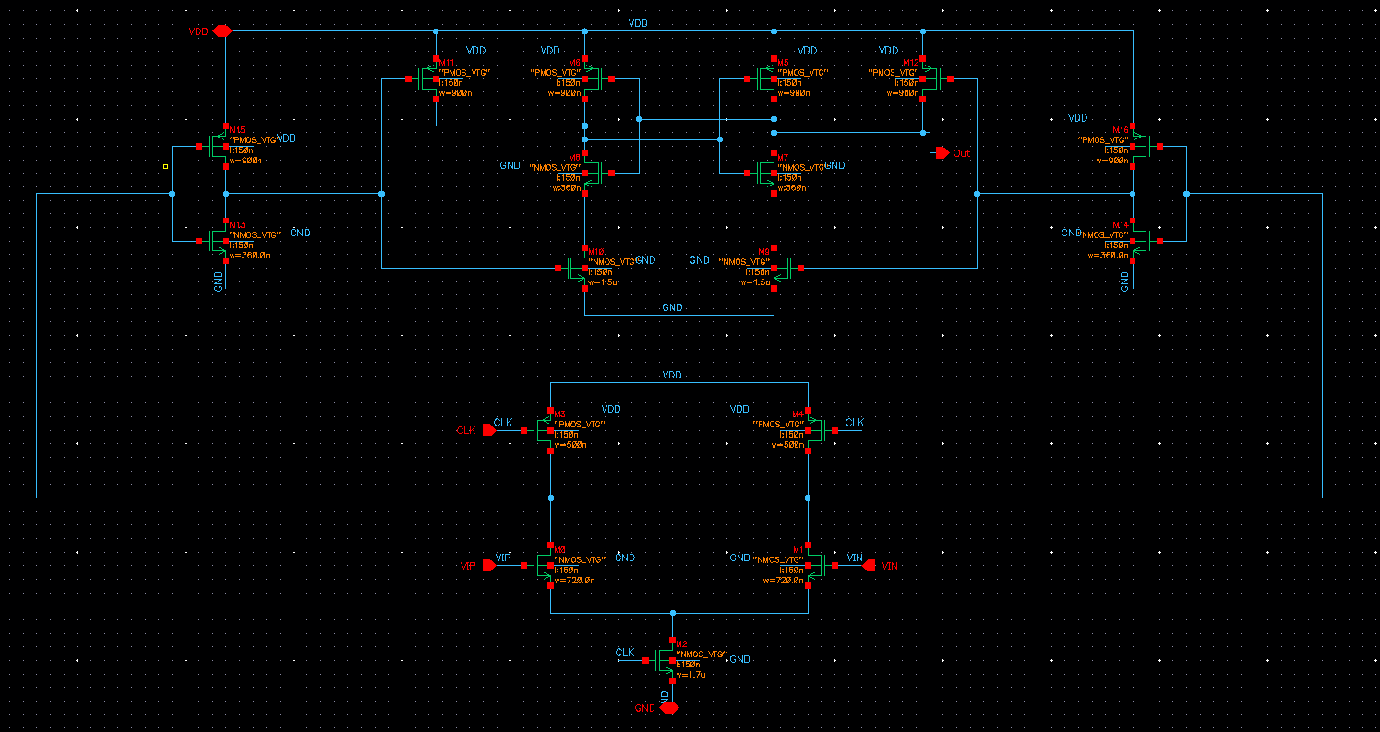
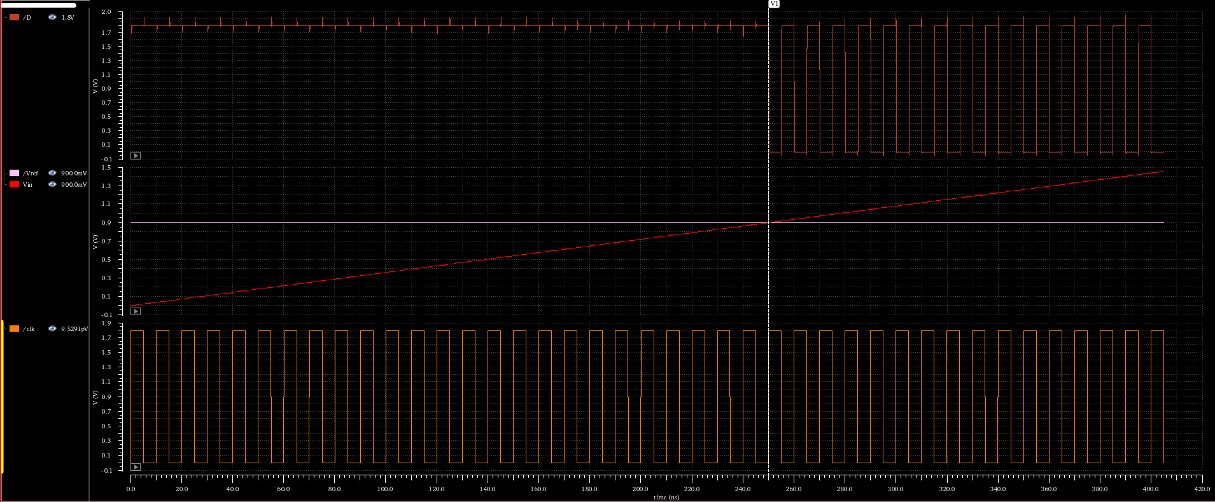
Dynamic Comparator
If clock is low, the outputs pre-charges to VDD.
If clock is high, the circuit evaluates.

Slide 9
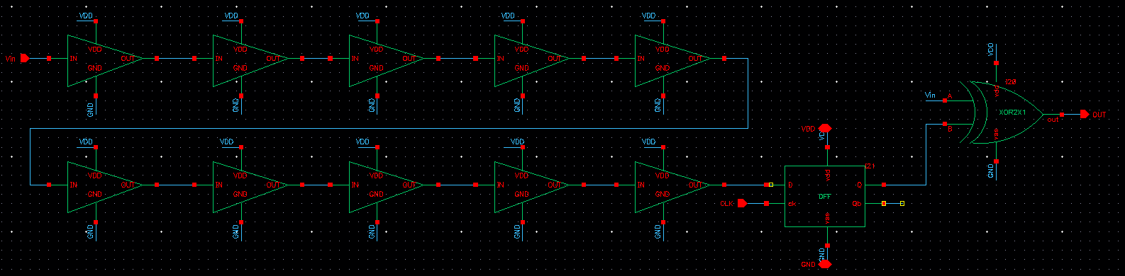
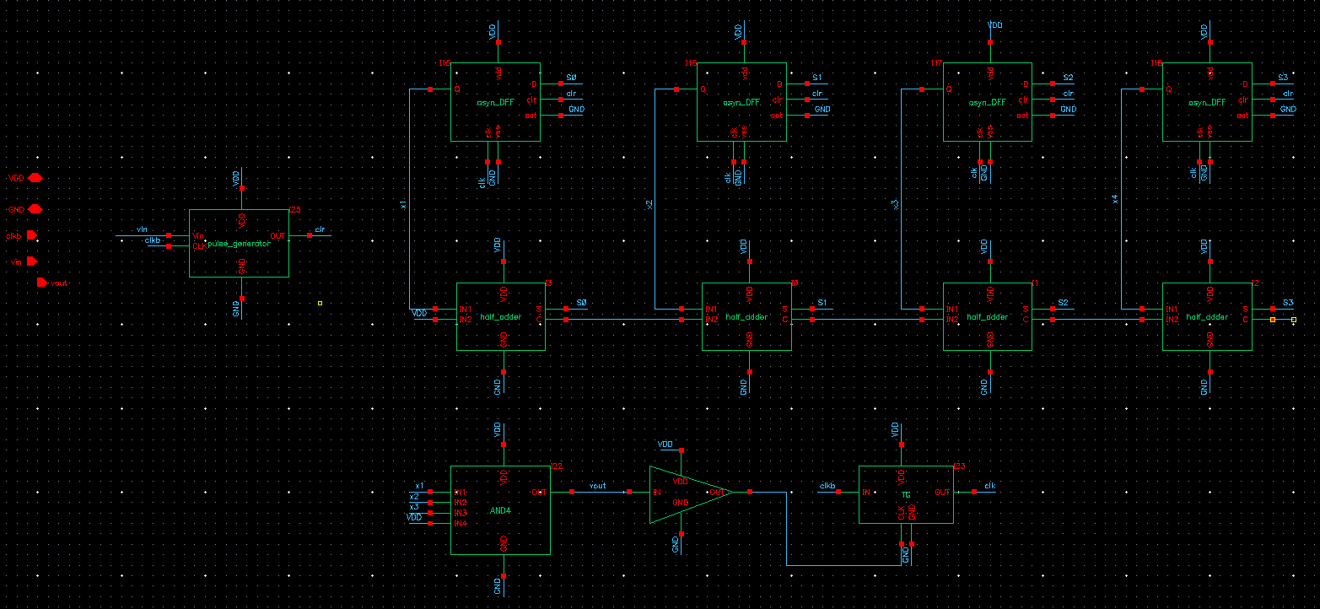
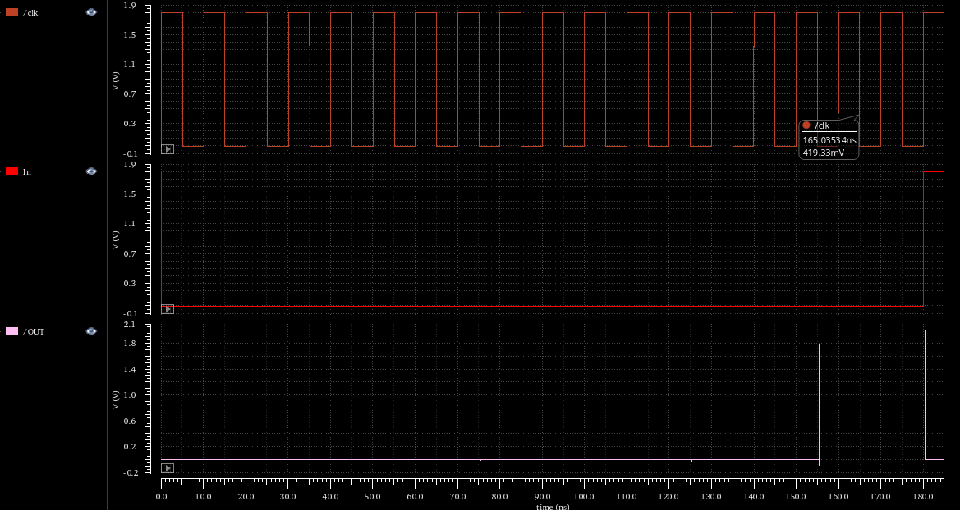
Counter_16 for incubation period.
Pulse generator generates a pulse whenever it’s input changes which resets all DFF in the circuit.
Then the adders count to 16.
FF are used to keep the previous state so the increment can be done.
Once {1 1 1 1} state is achieved, the output of the FF doesn’t change until the reset comes from the pulse generator.

Slide 10
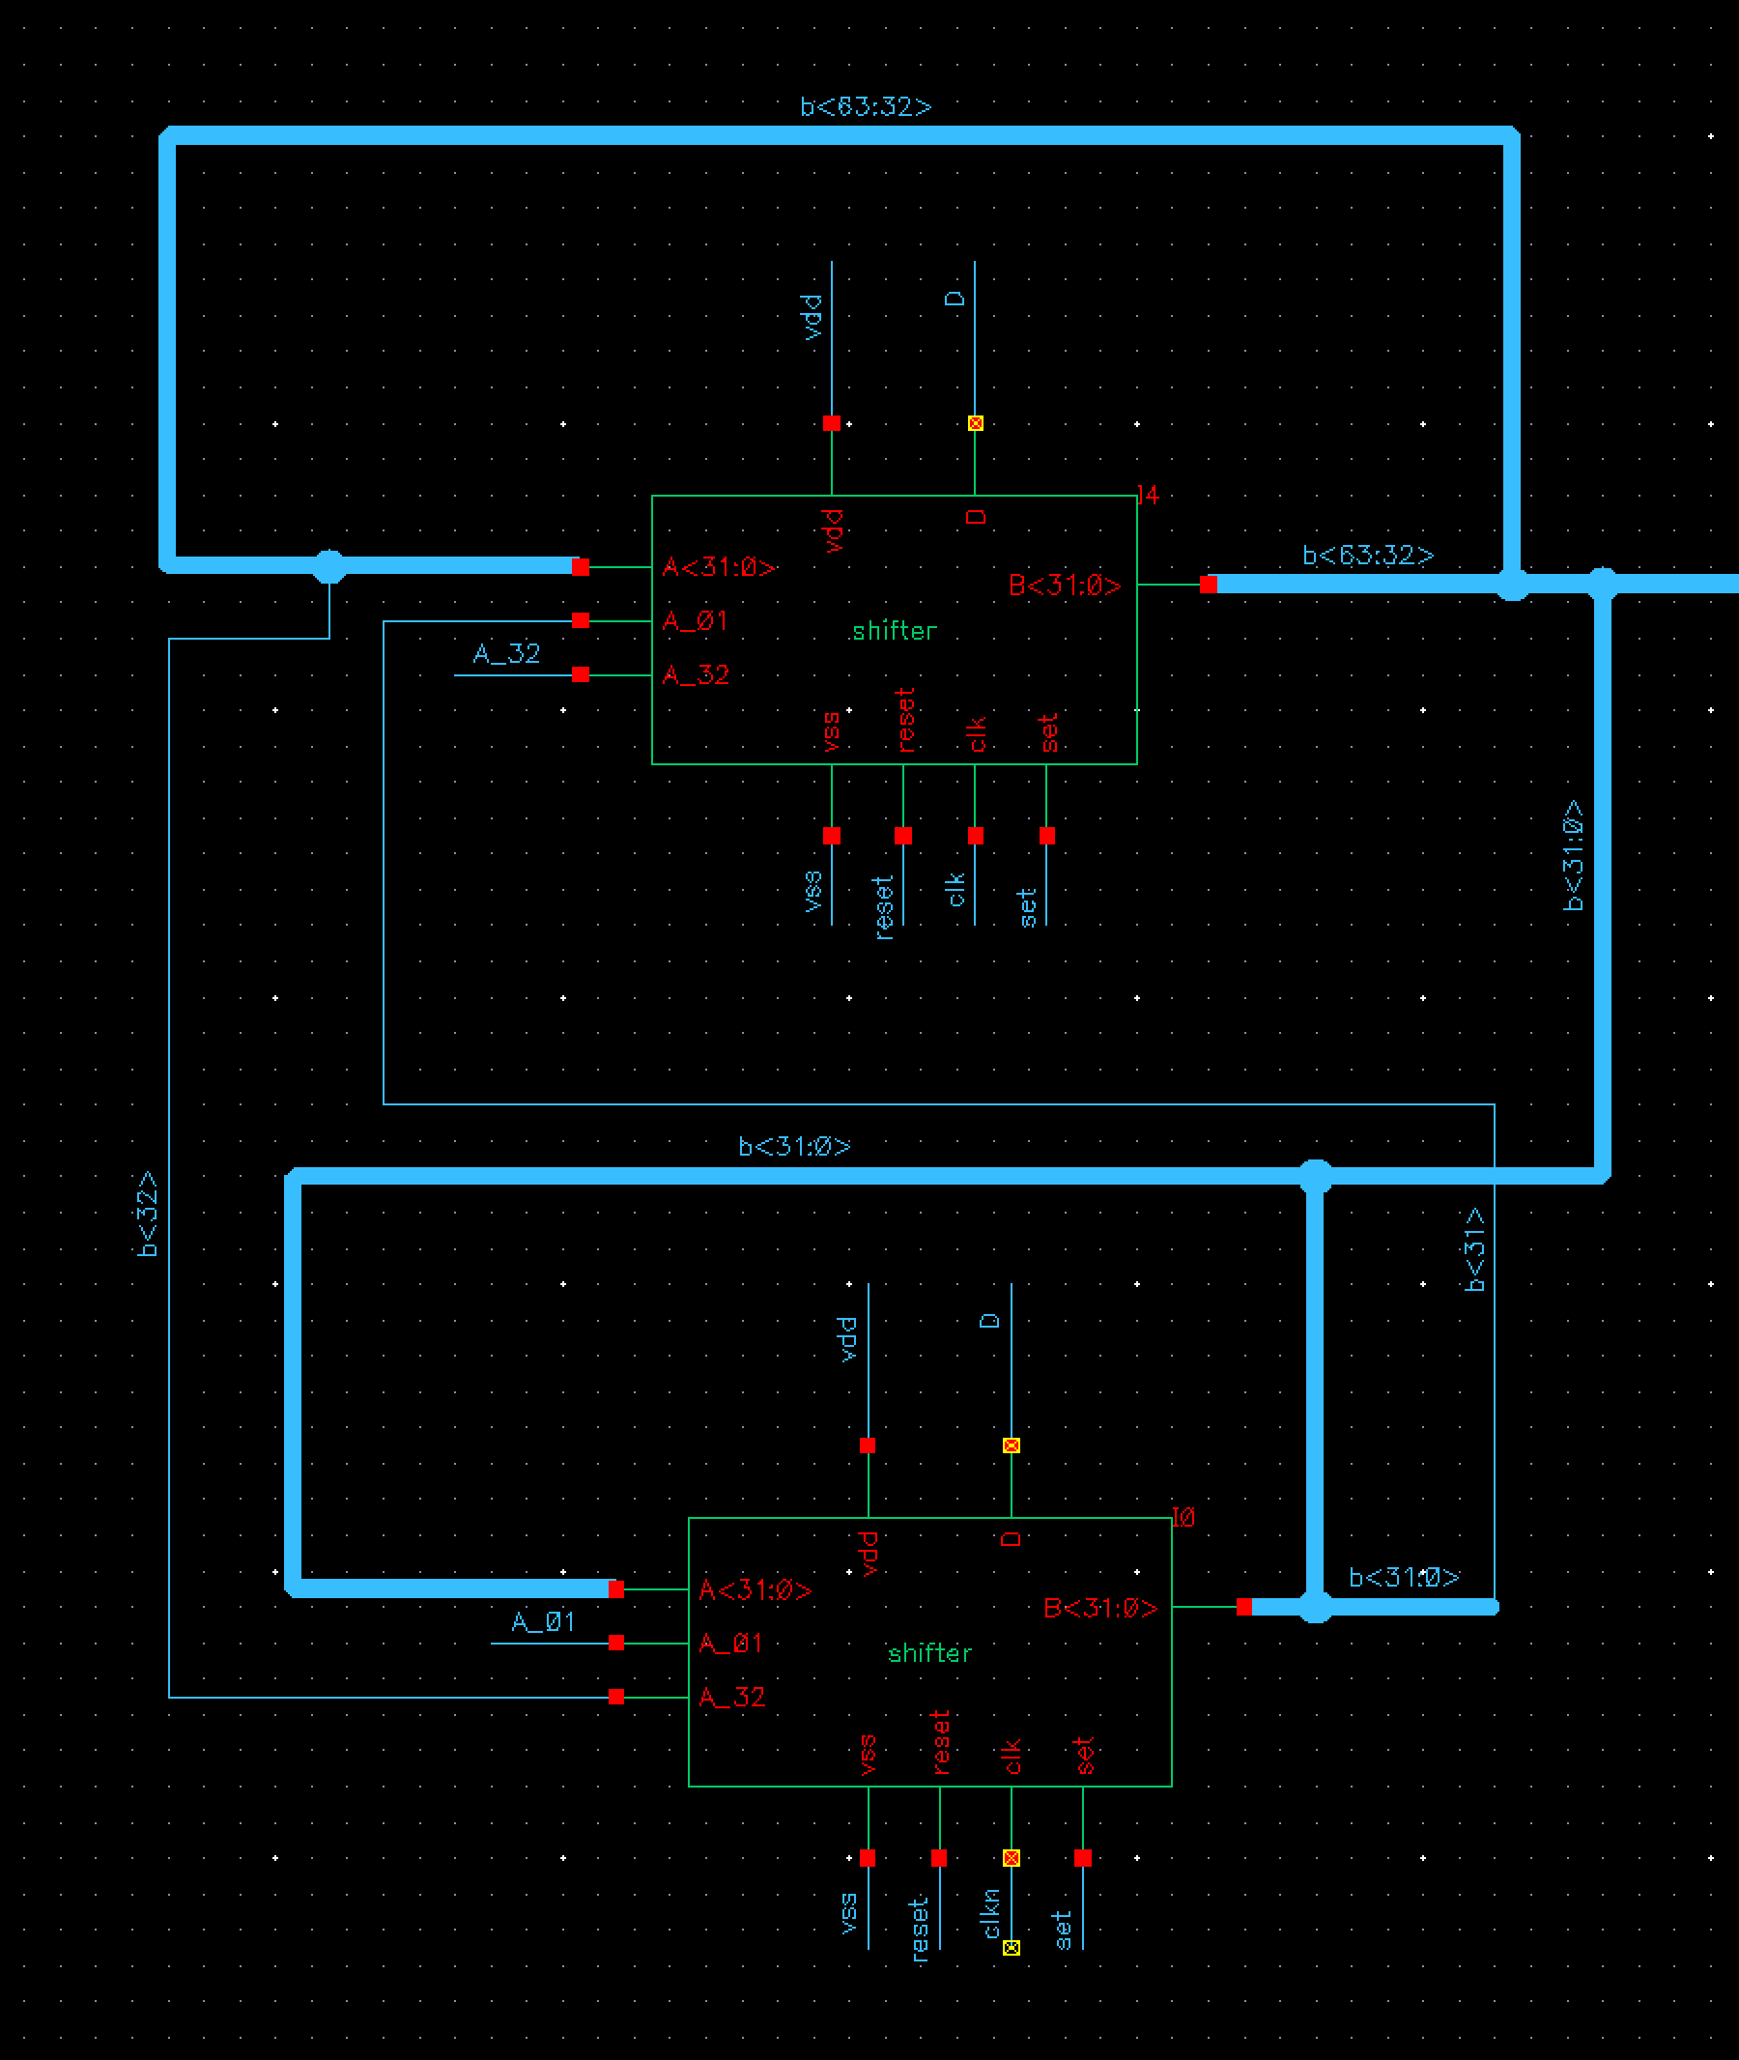
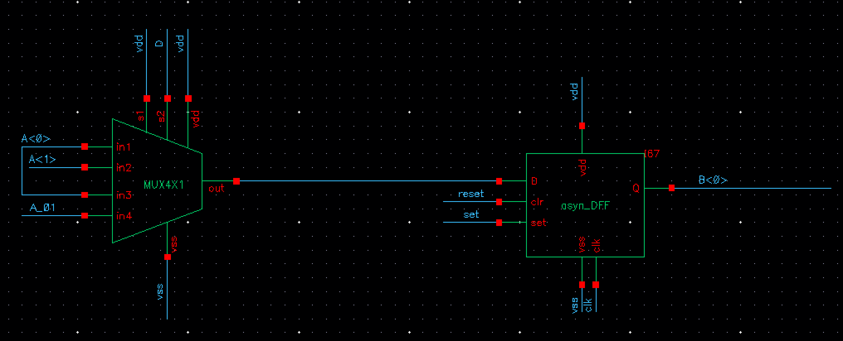
Barrel Shifter
1-bit (inside of 64-bits shifter)
Select line controls right shift(+1), left shift(-1), or doesn’t shift(0)
64-bits shifter

Slide 11
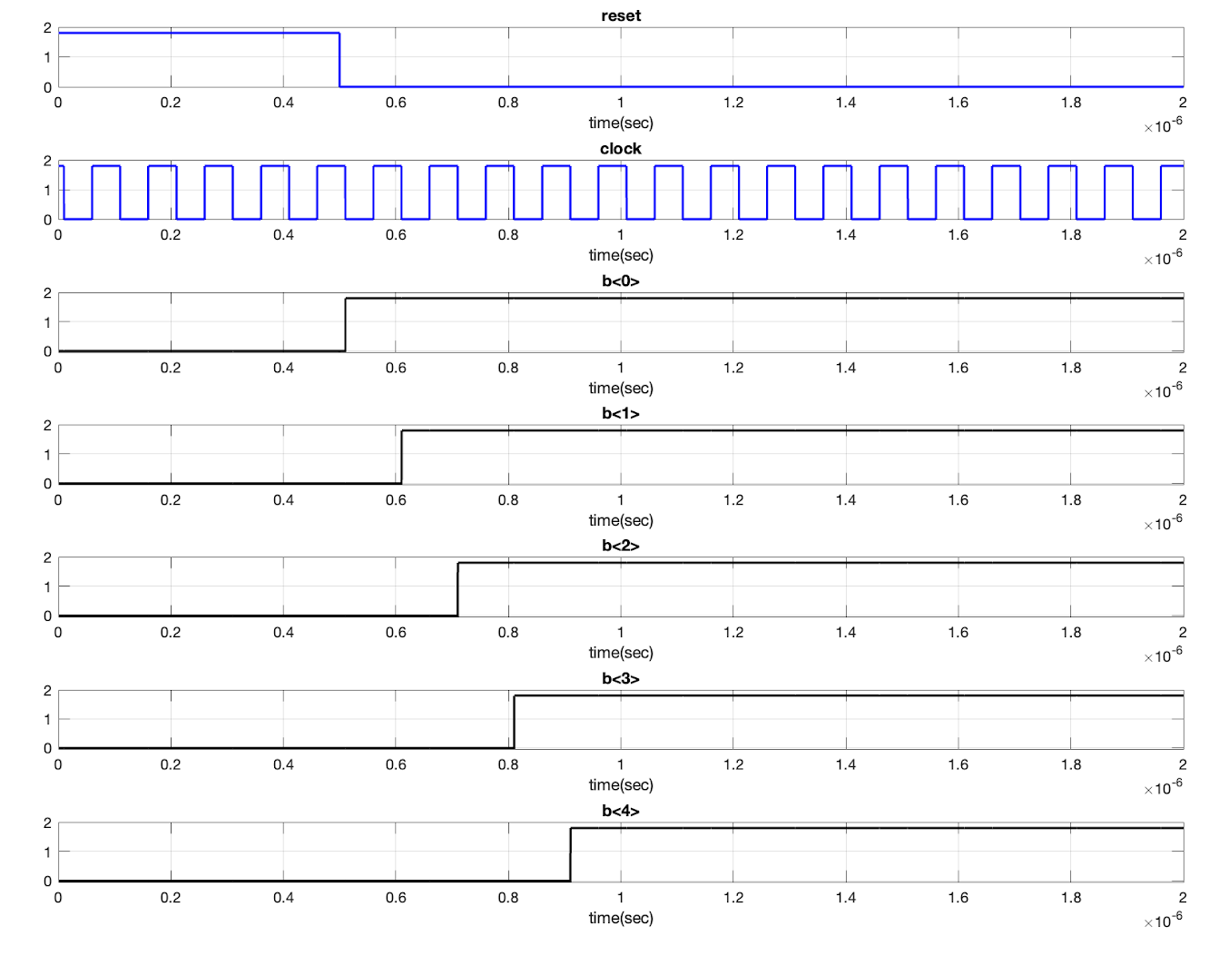
Barrel Shifter
The reset signal set all bits to zero at first
After the reset signal goes to zero, the shifter starts to shift right or left depends on the control signal.
The simulated signal shown here is the waveform when the shifter does right shift operation.

Slide 12
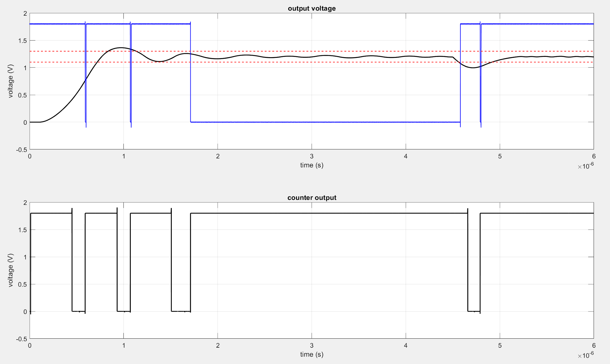
RDS and Adaptive Clock
If the output voltage is outside the range defined by the red lines, the circuit automatically increases the frequency.
The blue line signifies when Fs is high or low. If Fs is high, the blue line is high as well.
Counter is the signal that signifies the adaptive clock.

Slide 13
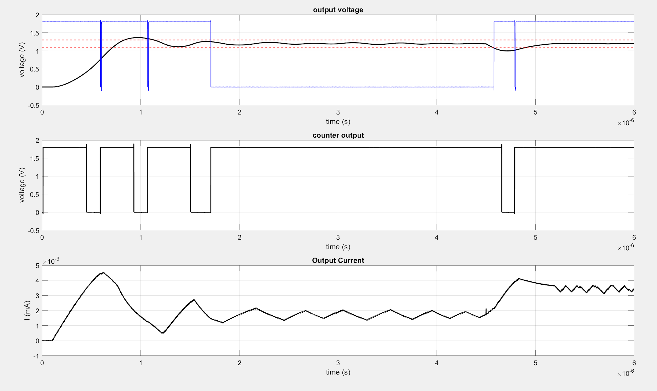
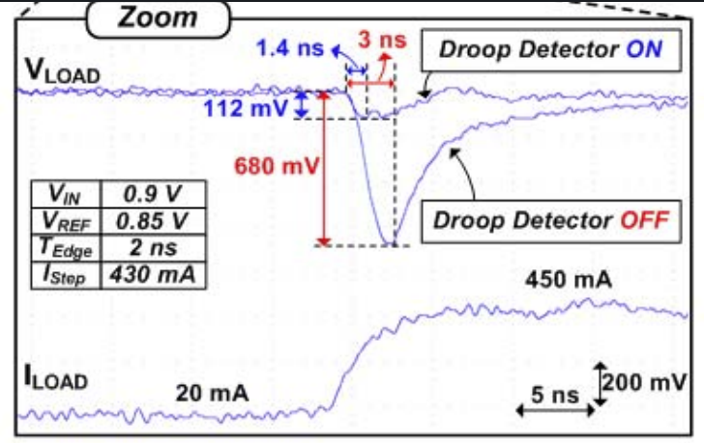
Load Current
The change of load current after the load changes.
Simulated

Slide 14
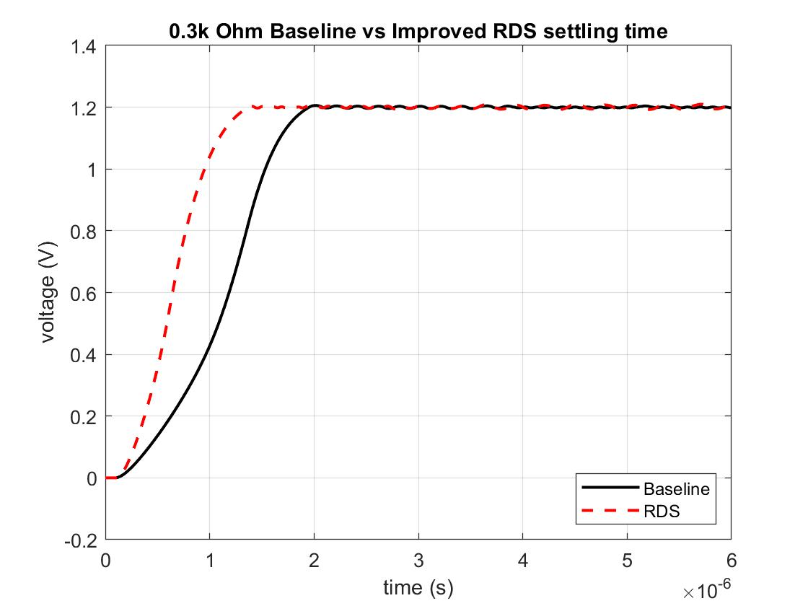
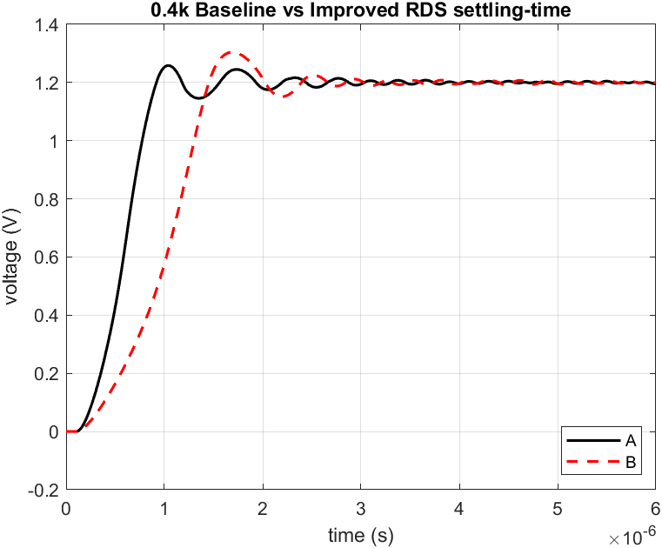
Baseline vs RDS
Comparison of the settling time of baseline and RDS.
RDS Fs = 100 MHz
Baseline Fs = 50MHz

Slide 15
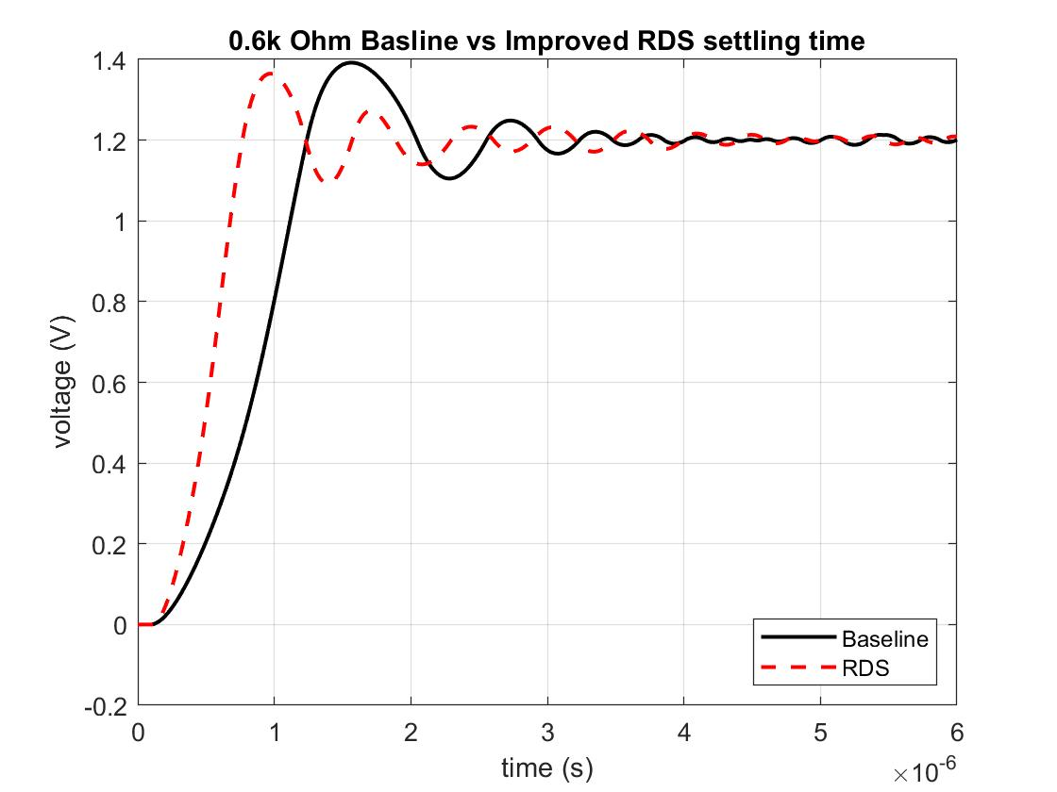
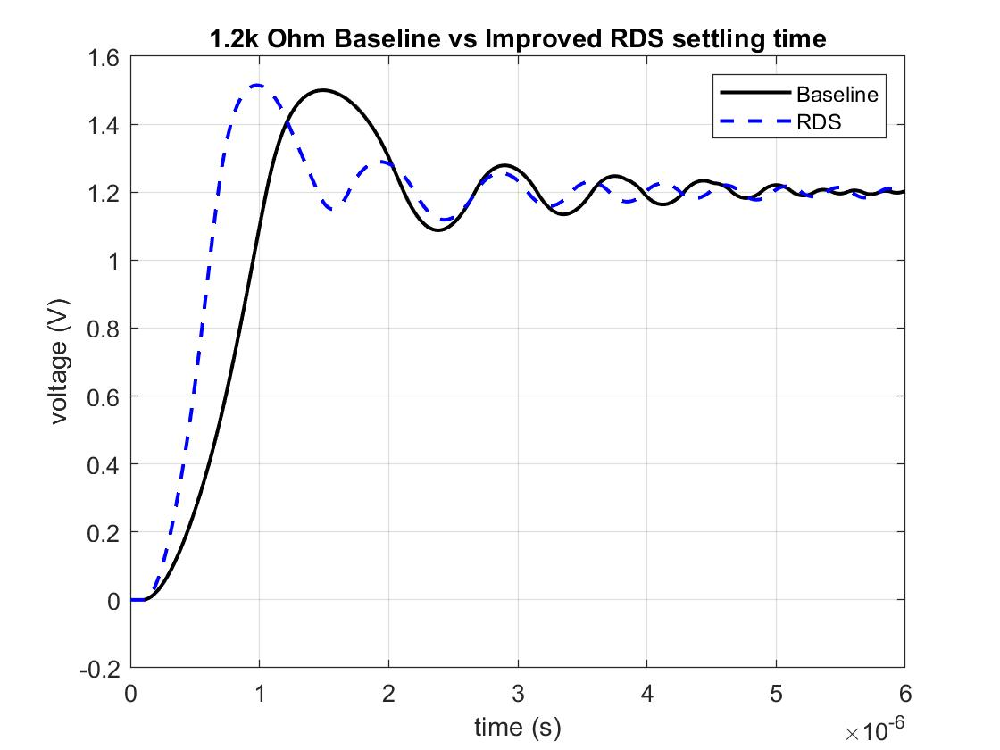
Baseline vs RDS
Comparison of the settling time of baseline and RDS.
RDS Fs = 100 MHz
Baseline Fs = 50MHz

Slide 16
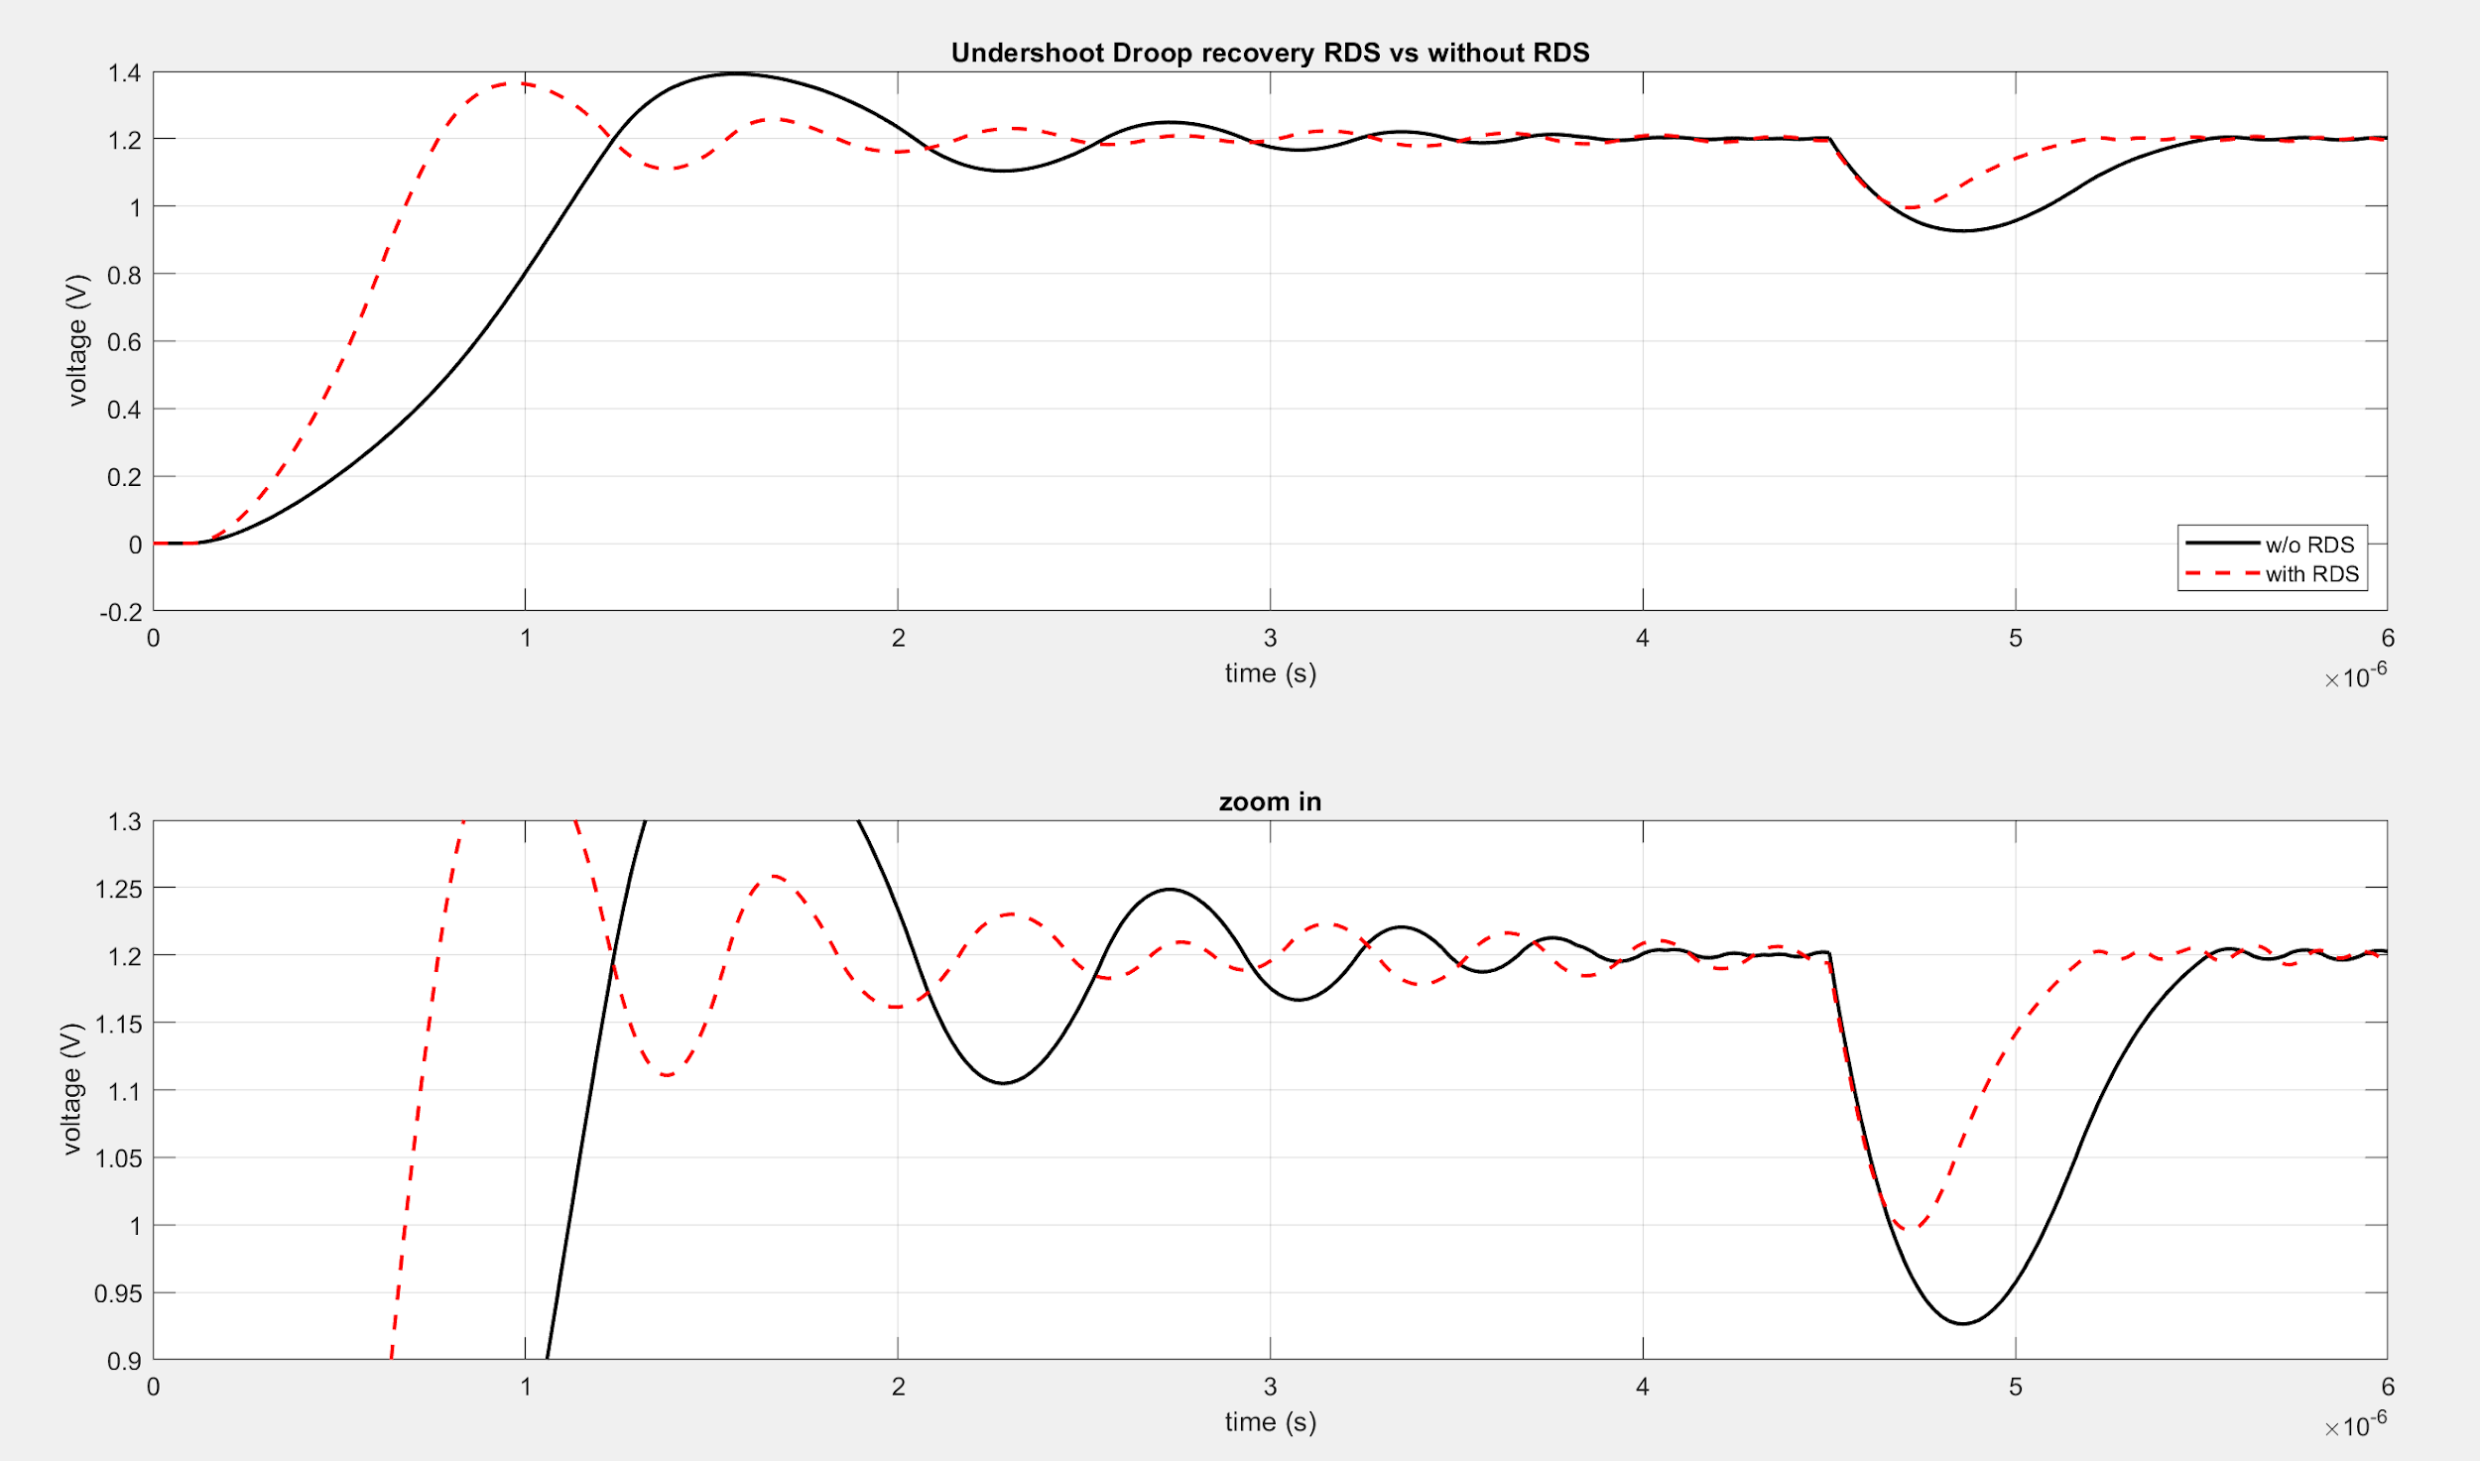
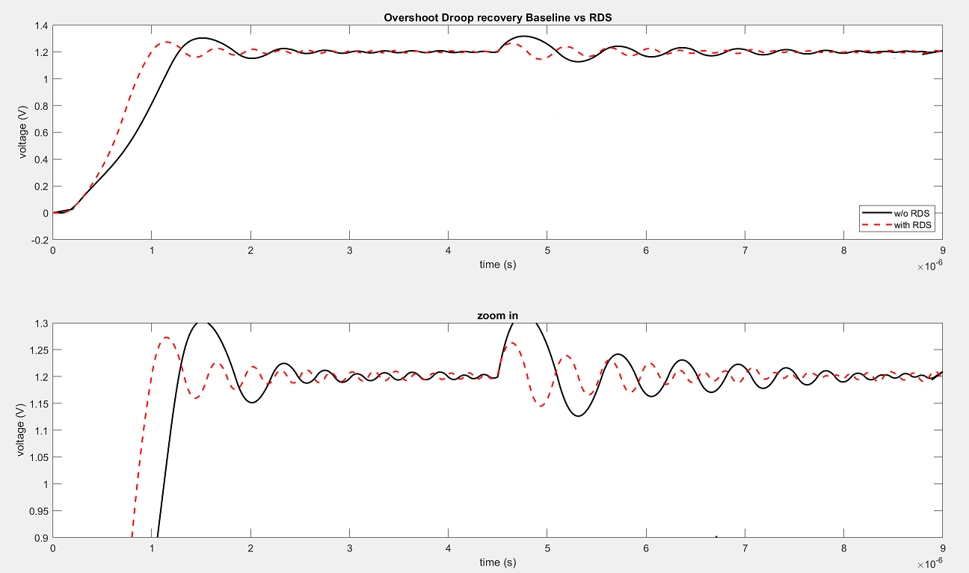
Baseline vs RDS voltage droop recovery
Since the RDS increases the sampling frequency once the droop crosses a certain value, the LDO tends to settle faster.

Slide 17
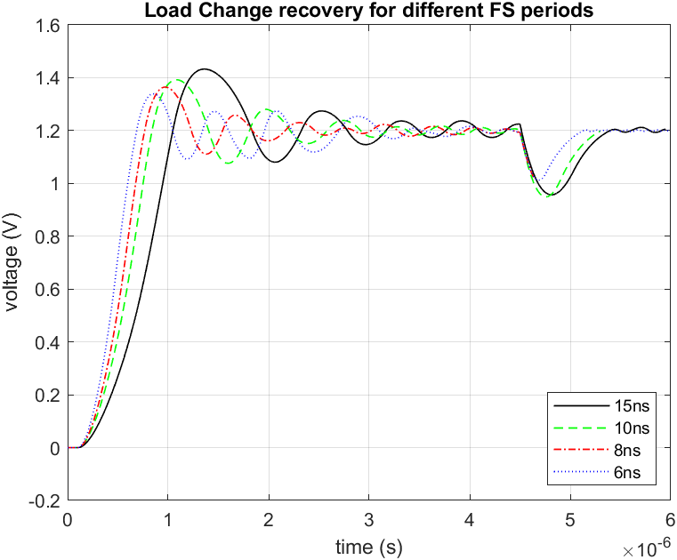
Fs vs Settling time
Increasing the sampling frequency reduces the settling time.

Slide 18
Future Work
Increasing Barrel Shifter Gain
Increasing the PMOS-Bank to accommodate larger currents.
Clock generation
Binary Search Shifter

